Slide 1

ADOBE FORMS

Slide 2

Lesson Objectives
After completing this lesson, participants will be able to -
Know the Adobe Forms Architecture
Understand Interface, context and Layout
Know how to integrate Adobe Form in an ABAP application program

Slide 3
Overview
Forms are used for mass printing in SAP systems. Besides using the printer for standard output you can also select the Internet (by using a generated HTML output), a fax, or e-mail as the output medium.
Tools Delivered by SAP for Form Designing
SE71 – Sapscripts
SmartForms – Smart Forms (introduced in SAP Basis Release 4.6C)
SFP – Adobe Form (As of SAP NetWeaver ’04 )
As of SAP NetWeaver ’04 (in SAP Web Application Server), you can use a new solution to create interactive forms and print forms for the optimization of your form-based business processes. This solution uses Portable Document Format (PDF) and software from Adobe Systems Inc. that has been integrated into the SAP environment

Slide 4
Overview - Features
Create form templates for the layout that include logos or pictures Edit forms online or offline
Forms can be filled in advance automatically with specific data from SAP applications and then sent to the correct recipients using secure methods
Automatic consistency checks for forms
Activate enhanced functions such as comments
Digital signatures and form certification
User-friendly tools reduce the time and costs associated with creating form layouts.
The usage of the PDF format means that forms retain their appearance regardless of the environment they are used in.

Slide 5
Overview - Advantages Over Smart Forms/SAPscript
Adobe Lifecycle Designer is an easy to use, flexible tool for designing forms Full integration into the SAP development environments for Java and ABAP
Graphics (BMP, JPEG, GIF, PNG, EXIF) can be included into forms directly no conversion required
Objects (including texts) can be rotated
Different page orientations (landscape, portrait) are possible within one
form
Graphical elements can be included in forms Existing PDF or Word documents can be imported
Barcodes can be printed on all printers of types Postscript, PCL, PDF, or Zebra
Mailing and faxing is easier
Scenarios and integration into browser-based applications are possible (Web Dynpro for Java or ABAP)

Slide 6
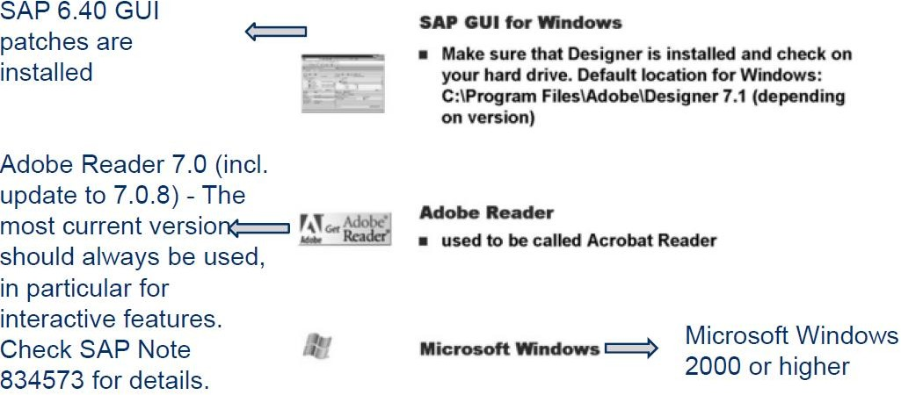
Overview - Adobe Designer: - Technical Pre- requisites

Slide 7
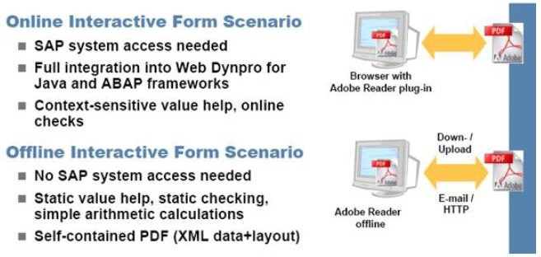
Overview - Adobe Form – Types
There are two basic types of forms:-
1.Interactive Forms ( Basic scenarios )
Online
The user is logged on to the SAP system when he or she fills out the form.
Offline
The user is not logged on to the SAP system when he or she fills out the form. Once the form has been filled out, the user sends it to the issuer of the form, for example by e-mail. The SAP system of the issuer then extracts the data from the form.

Slide 8
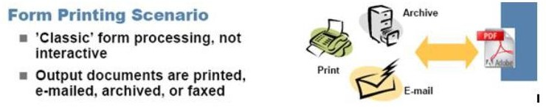
Overview
Print Forms - Used normally for Printing/Fax/Email
Forms for Printing, E-Mail, or Fax
You can use the Form Builder (integrated into ABAP Workbench) to create
PDF-based print forms that you can then print or send by e-mail or fax. When you create these print forms, you can rely on the tried and trusted principle of separate data retrieval and form layout processes.
This enables you to make changes to either one of the processes, without affecting the other.
PDF-based print forms can be used for the following: Order confirmations Invoices , Account statements , Checks etc

Slide 9
Architecture - Structure
A PDF-base print form has the following attributes:
A form interface that sends the application data to the form.
A form context that contains the form logic. This logic controls the dynamic formatting of the form. For example, it enables variable fields to be displayed; it specifies that certain texts appear only under certain conditions (one text for a first warning and a different text for a second warning); and it can specify that invoice items can be processed repeatedly in a table.
A layout. In the layout, you define how the output data is positioned, its
appearance in graphics, and the design of the pages.

Slide 10
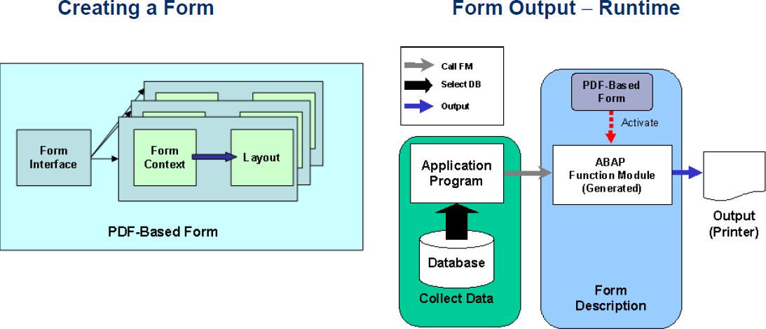
Architecture
The following graphics show you the architecture that is implemented when
you create and print a PDF-based form.

Slide 11
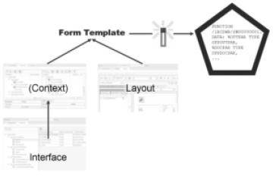
Architecture - The Tools Involved (Design Time)
Interface (transaction SE80
or SFP)
Reusable
The interface defines which data a
Program can possibly pass on to a form.
Form template (transaction SE80 or SFP)
Consists of a context and the layout.

Slide 12
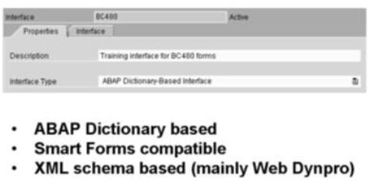
Interface
Every PDF-based form needs to have an interface; it is the link between the
ABAP program and the form.
The program can pass data to the form only if it is defined in the interface, and (most of) the dynamic data used in the form layout will be defined in the interface.
To access interface maintenance, use transaction SFP. Alternatively, use
transaction SE80 and choose Other object.
Types of an Interface

Slide 13
Interface
The types “ABAP Dictionary based” and “Smart Forms compatible”
are used for print scenarios.
“XML schema based” (which was introduced in SAP NetWeaver 2004s) is
primarily used for Web Dynpro scenarios.

Slide 14
Interface - Form Interface
A form interface of the type ABAP Dictionary has only one default import parameter (/1bcdwb/docparams of type sfpdocparams). It is used to determine a form's locale (language and country) and whether the form will allow interactive features.
Export parameters can be added only for those interfaces that are compatible with Smart Forms.
Exceptions that you declare in an interface can be raised in ABAP coding of a form. They are based on the traditional exception concept (not the class- based concept that was introduced in SAP Web Application Server 6.10).
You raise an exception as such: RAISE <exception>. (Alternative: MESSAGE
<message_type><message>(<message_class>) RAISING <exception>

Slide 15
Interface – Global Definitions
Global Definitions - There are also parts to an interface that are
actually invisible from outside, that is, they cannot be accessed from the application program. Among them are the global definitions, initialization coding, and currency/unit fields.
Global fields: Global fields can be integrated in the form layout.
Field symbols: Field symbols might act as placeholders for variables. They are useful in dynamic programming and for speeding up the processing of internal tables.
Global types: If your global fields (or any fields that you might declare within ABAP coding) need types other than ABAP types (i, n, f, c, p, and so on) or Dictionary types, you can create local types in the editor that opens when you choose Types.

Slide 16
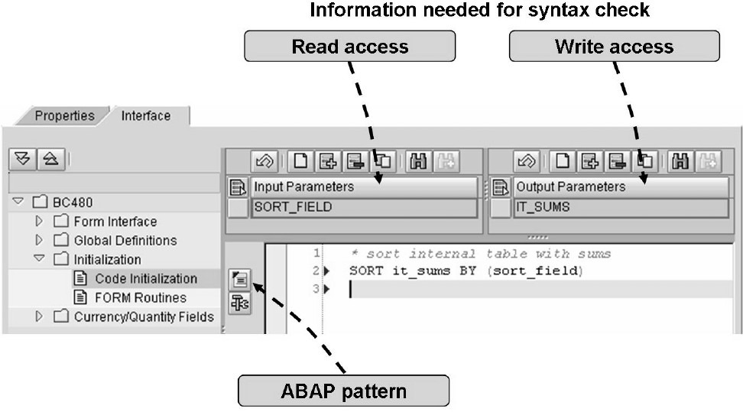
Interface - Initialization

Slide 17
Interface - Initialization
During initialization, data coming from the program can be changed before it is sent to the form. In forms that have not been migrated from Smart Forms, initialization is the only time when ABAP coding can be executed.
Even if the initialization coding makes use of form interface fields or global fields, you still have to make them known to the initialization coding. Enter those fields that you read from under Input Parameters, and those that you set under Output
In the initialization coding, you can call form routines that you have created in the interface: PERFORM ... Form routines make sense for coding that needs to be executed several times. You define form routines by using the ordinary ABAP syntax FORM xyz... ENDFORM.

Slide 18
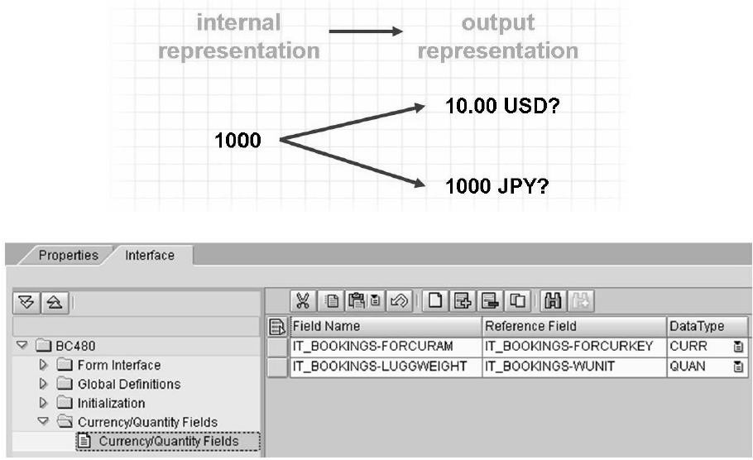
Interface – Currency/Quantity Fields

Slide 19
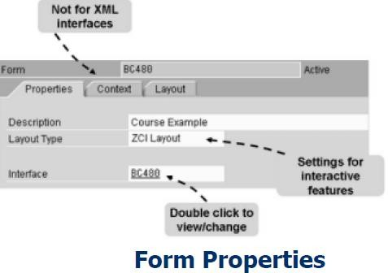
Context
The context is essential, as it provides the source for data for a form. Apart from static elements, only those texts, fields, images, and so on can be included in the layout of a form that have been integrated into the form's context. However, the context should not be overloaded, as this will have a negative impact on printing performance.
It can be seen as a subset of the interface enriched with some form specific information.

Slide 20
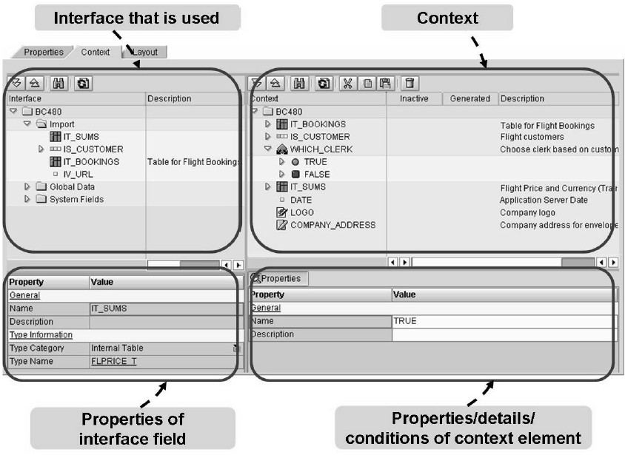
Context - General Handling of the Context

Slide 21
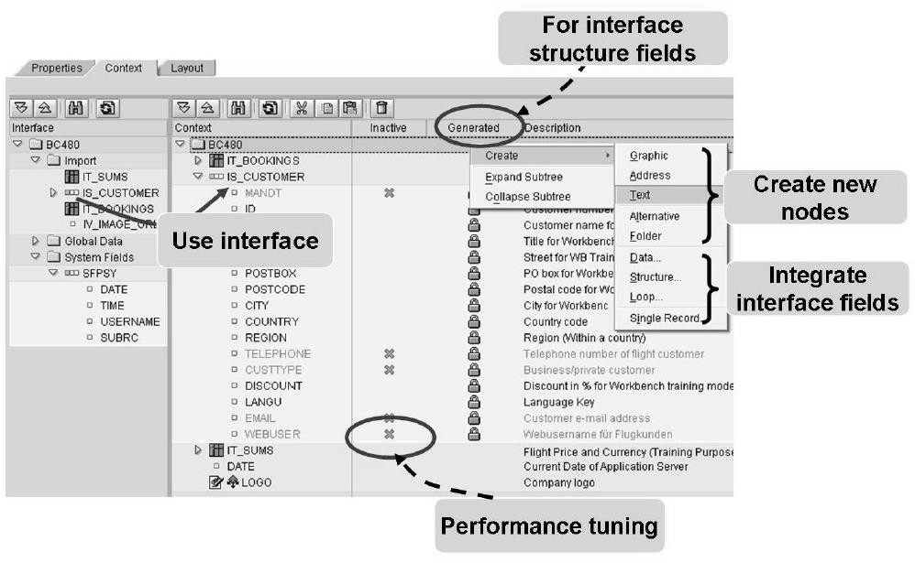
Context - Using the Interface

Slide 22
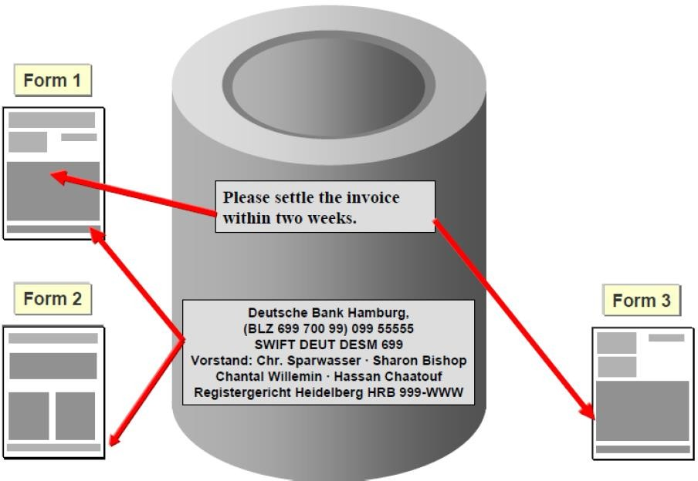
Context - Text Modules and SAP script Texts

Slide 23
Context - Text Modules and SAP script Texts
You need to create the texts only once and can then reuse them as
required.
You make changes centrally only once without having to modify the actual forms.
Typical examples include headers (company address), footers (company information like board members and so on), and whole pages containing introductions or terms of trade.
Use text modules of Smart Forms and also include texts (that is, SAPscript texts).
Run transaction SMARTFORMS (for text modules) or SO10 (for include texts

Slide 24
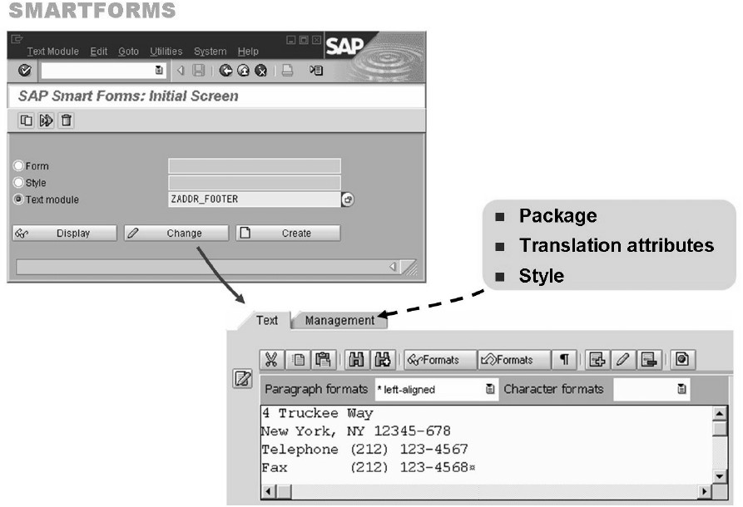
Context - Creating Text Modules

Slide 25
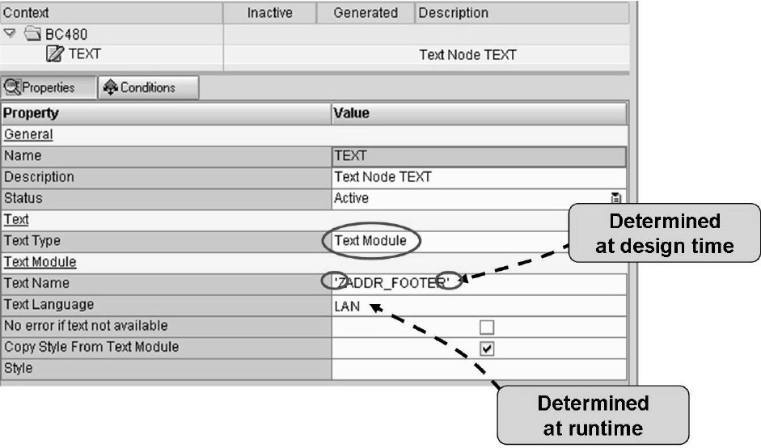
Context - Including Text Modules

Slide 26
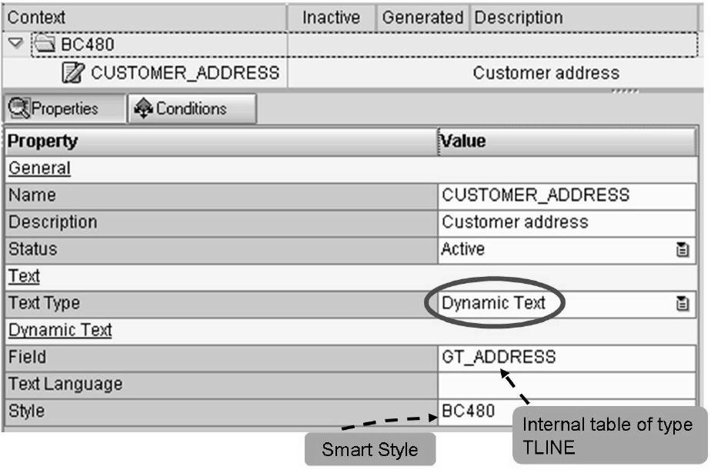
Context - Including Dynamic Texts

Slide 27
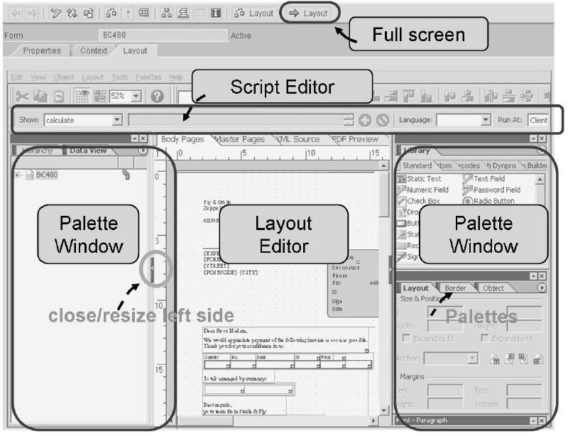
Designer - Adobe Lifecycle Designer: Overview

Slide 28
Designer - Adobe Lifecycle Designer: Overview
In SAP NetWeaver 2004s, a pushbutton Layout was added to transaction
SFP, which displays Designer in a full screen
The Designer workspace consists of four main areas. All but the central one (the Layout Editor) can be closed by choosing Palettes → Workspace (Palettes →Manage Palettes in some versions).
In the top area, the Script Editor can be displayed. It allows you to enter scripts for calculations. You can choose between JavaScript and Adobe's FormCalc.
The subdivisions of the left and right areas are called palette windows with further subdivisions of palettes
Note: You can always return to the standard by choosing
Palettes→Workspace → Reset Palette Locations.

Slide 29
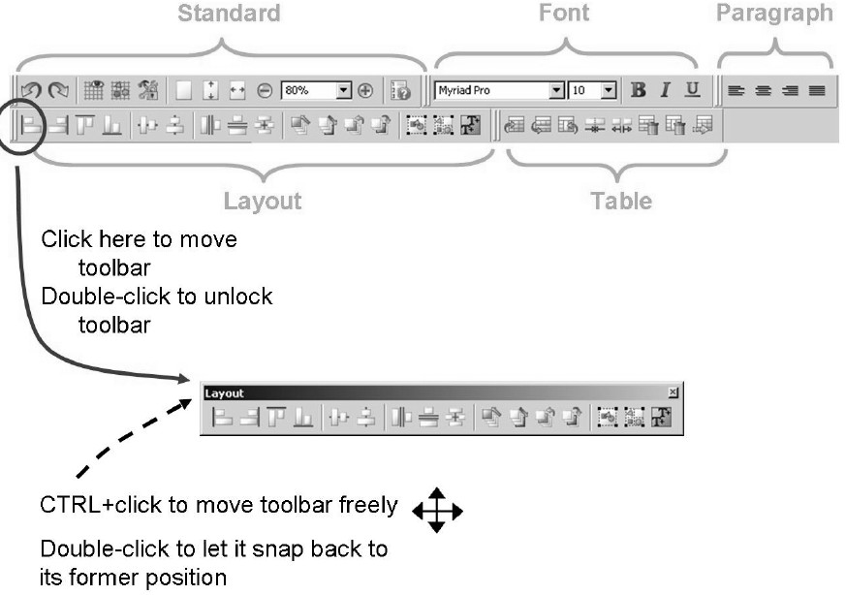
Designer - Toolbars

Slide 30
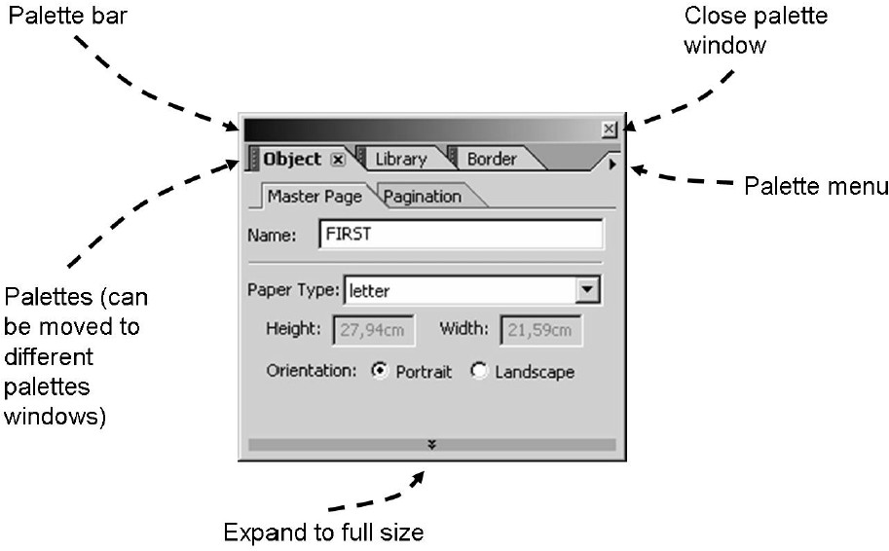
Designer - Palette Windows: Handling

Slide 31
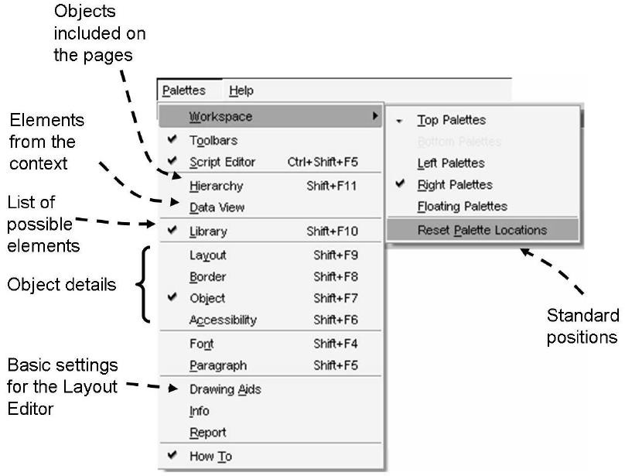
Designer - Palettes: Overview

Slide 32
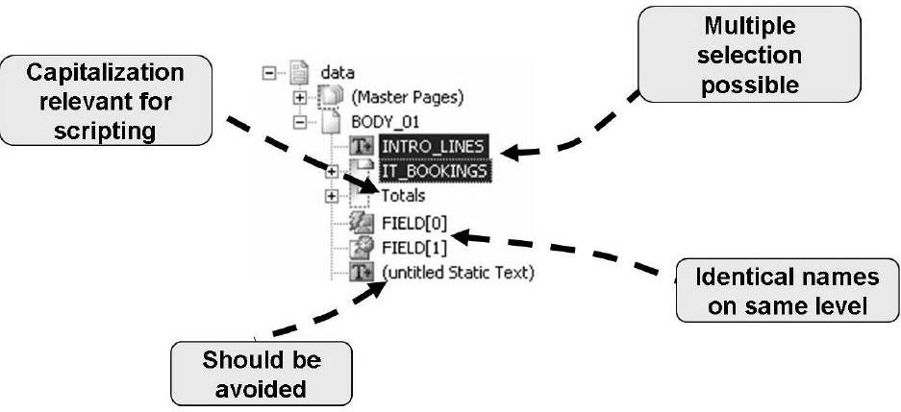
Designer - The Hierarchy Palette

Slide 33
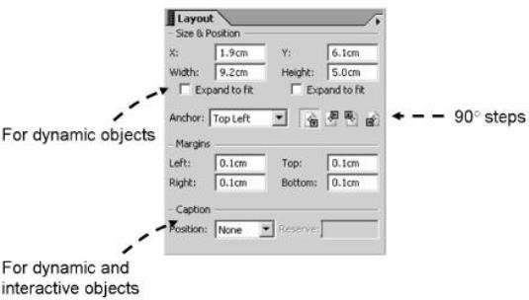
Designer - The Layout Palette
1.You can position and size an object by
clicking the resize handles of the Layout
Editor and moving them. You can
achieve the same by typing in the
coordinates and the width/height in the
Layout palette.
2.For dynamic elements (like dynamic
texts that come via the application
program) you can select Expand to fit for
the width and/or height to avoid the
disappearance of lines.
3.You can set the margins, for instance,
the space between text and the borders
of the text object.
4.Dynamic and interactive objects (like
text fields or checkboxes) will normally
need to have a caption. You can
determine its size and its position with
regards to the object itself.
5.Objects can be rotated in 90° steps.
You must specify around which anchor
point the object should be rotated

Slide 34
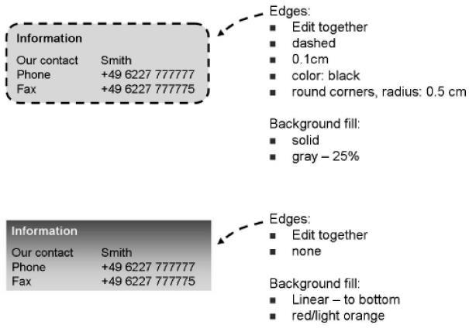
Designer - Borders and Background Colors
1.On the Border palette, you can
determine edges and/or
background fills.
Edges can be edited together or individually.
For a background fill, you can
choose between none, solid (one
color) and various patterns for two
colors.
4.For objects that are non-static (like a text field), you can also
specify the border properties of the
fill able areas. For example, you
might choose to have a
background color for a text field
that differs from its caption color.
To achieve this, select the object.
In the Object palette, choose the
Field tab. From the Appearance
list, select Custom.

Slide 35
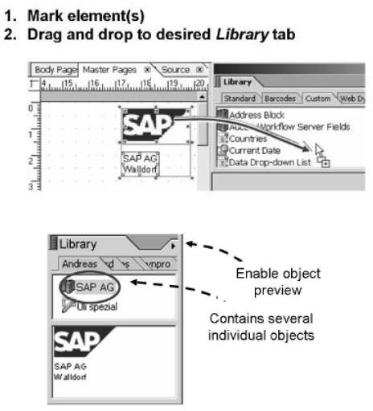
Designer - Library
If you create an element and need to use it several times in your layout, it can be added to a tab page of the Library palette. You can then drag and drop your element from the Library, just like all predefined elements. All standard objects that come with Designer can be restored to any Library tab by selecting Restore Standard Objects from the palette menu. A library with its objects can also be published on a server

Slide 36
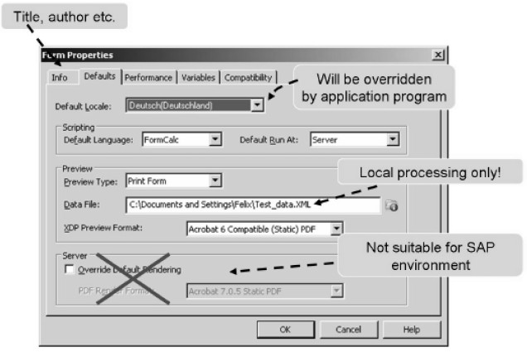
Designer - Form Properties

Slide 37
Designer
1.Master Page 2.Body Page 3.Content Area 4.Sub forms

Slide 38
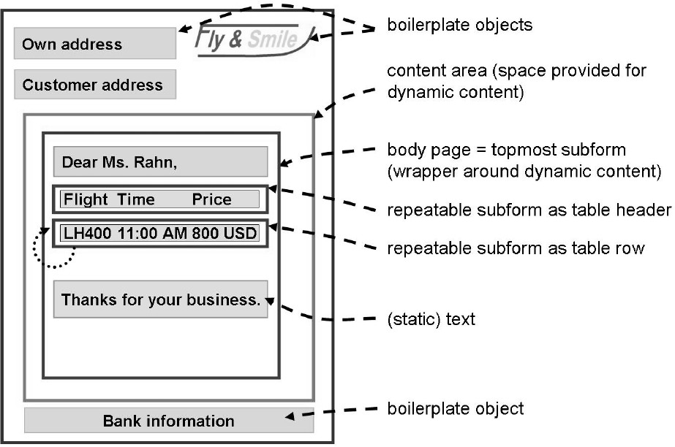
Designer

Slide 39
Designer
Every form design contains at least one master page that Adobe Lifecycle
Designer creates automatically.
You can put objects on a master page that will appear on any resulting page at runtime, for example, your company logo. Such objects that never change are called boilerplate objects.
To some extent, the boilerplate objects of a master page could be compared
to secondary windows in SAPscript or Smart Forms.
On a master page, you must include at least one content area. This defines the size to be used for dynamic output Content
Content areas can be included only on master pages.

Slide 40
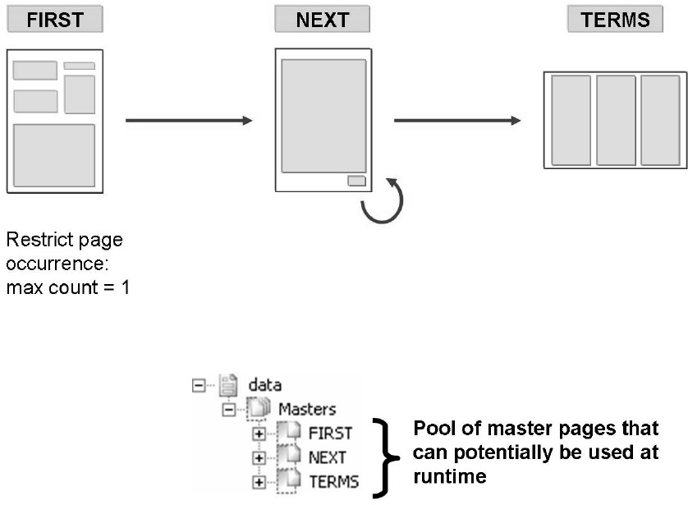
Designer - Inserting Several Master Pages

Slide 41
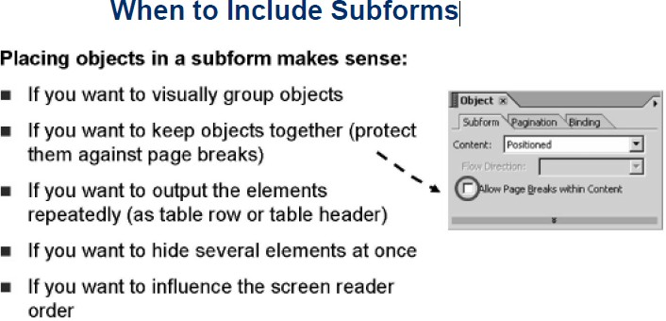
Designer
Subforms can be thought of as folders containing several objects. They can be used for the simple reason of keeping order in the Hierarchy, as it is possible to expand and compress subforms.
Subforms also help to rearrange several objects at a different place in the form.

Slide 42
Designer - Types of Subforms
If of type Positioned, objects of subforms can be laid down at their exact position at runtime, relative to the subform. For example, if a text field has been positioned at the top left corner of a subform of type Positioned, it will always be positioned at the top left corner of the subform, independent where on a page this subform is included. (The Hierarchy position of an object within a subform of type Positioned is irrelevant for its layout position.)
If of type Flowed, the objects will follow each other, depending on the space they require at runtime. A body page (as the topmost subform) is typically of this type

Slide 43
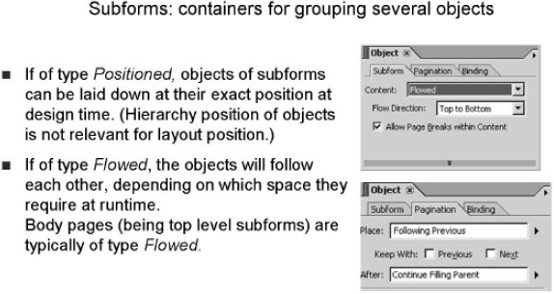
Designer - Types of Subforms

Slide 44
Layout
1.Insert static elements into a form: images, texts, and graphical objects 2.Set object properties for static form elements
Insert dynamic elements into a form: text fields, image fields, date/time fields, floating fields
Set the data binding (the connection between the layout fields and the business data)
Apply patterns (picture clauses) to influence field output 6.Insert tables into a form
Format tables
Set a header for a table

Slide 45
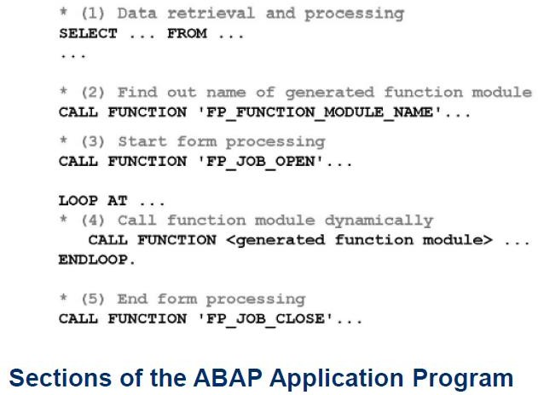
Integration into ABAP Programs
Designing the layout of a form is the most time-consuming part of administering a printing scenario. However, a form itself cannot be run; it can only be previewed with test data. An ABAP program is required to process it.

Slide 46
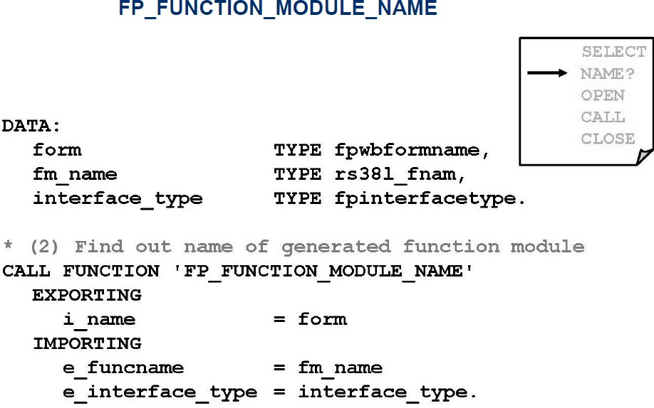
Integration into ABAP Programs

Slide 47
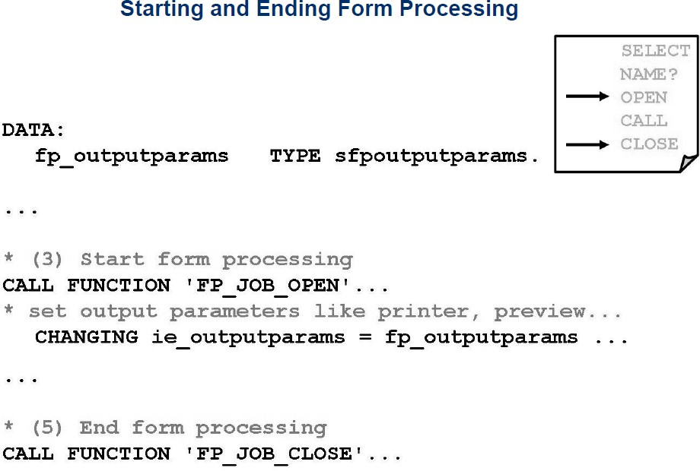
Integration into ABAP Programs

Slide 48
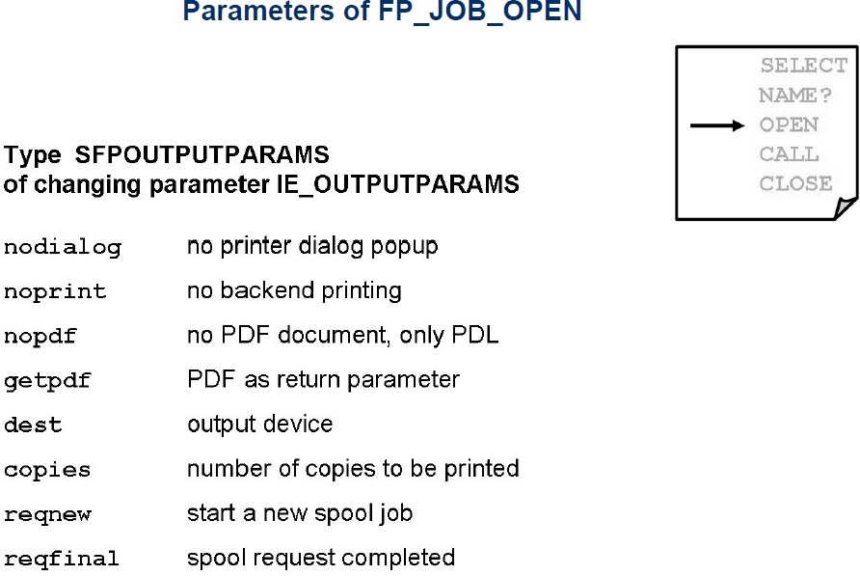
Integration into ABAP Programs

Slide 49
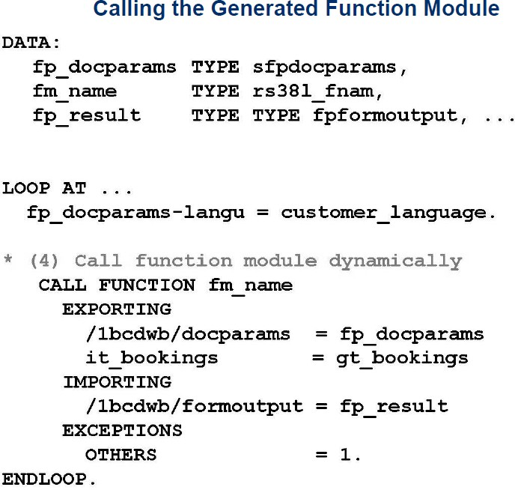
Integration into ABAP Programs

Slide 50

Summary
In this lesson, you have learnt:
The Adobe Forms Architecture
The Interface, context and Layout
How to integrate Adobe Form in an ABAP application program

Slide 51
THANK YOU

